Slide 1


Umer Shahzad

Slide 2

Umer Shahzad

Slide 3
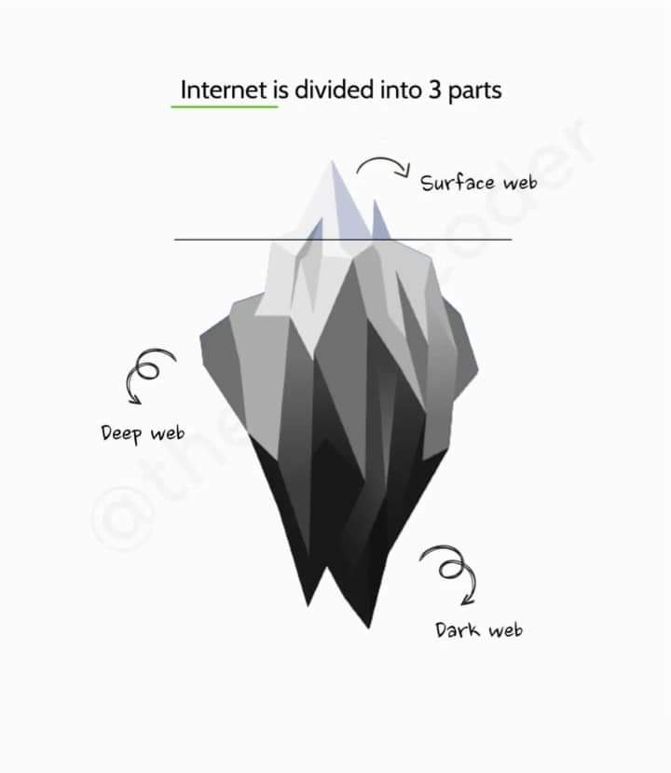
Umer Shahzad

Slide 4
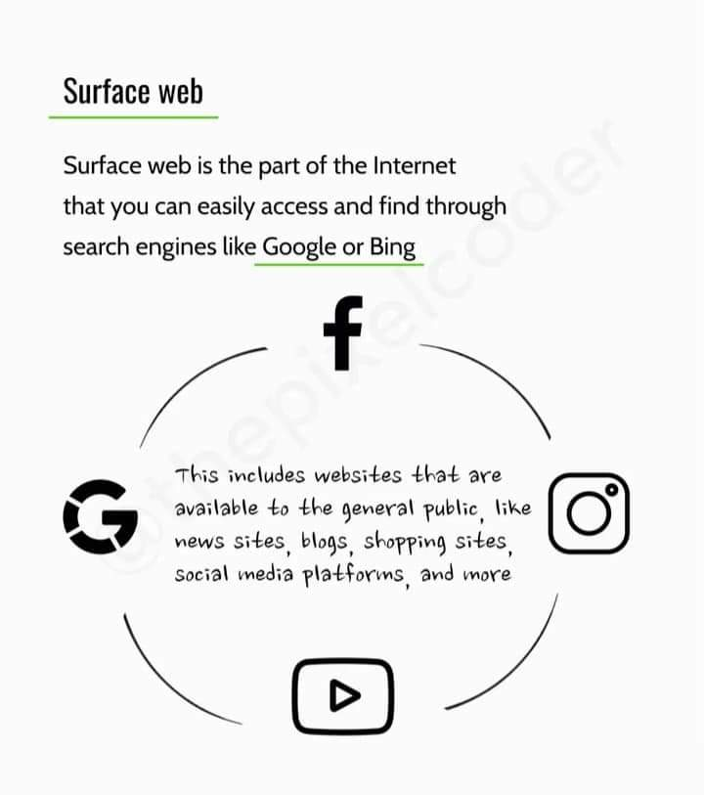
Umer Shahzad

Slide 5
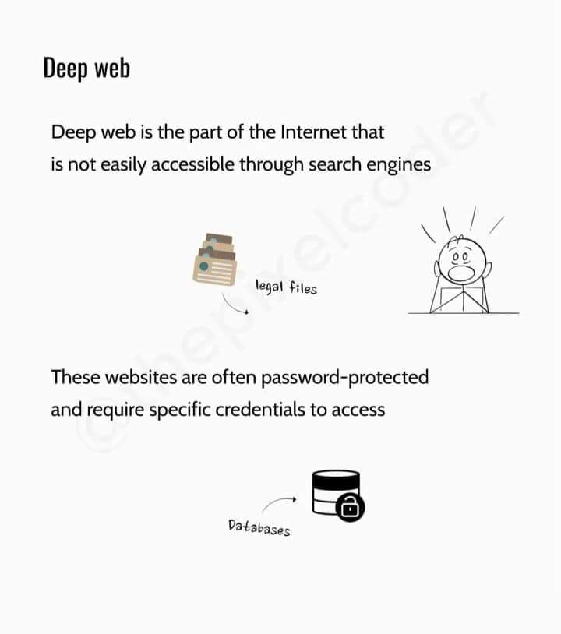

Slide 6
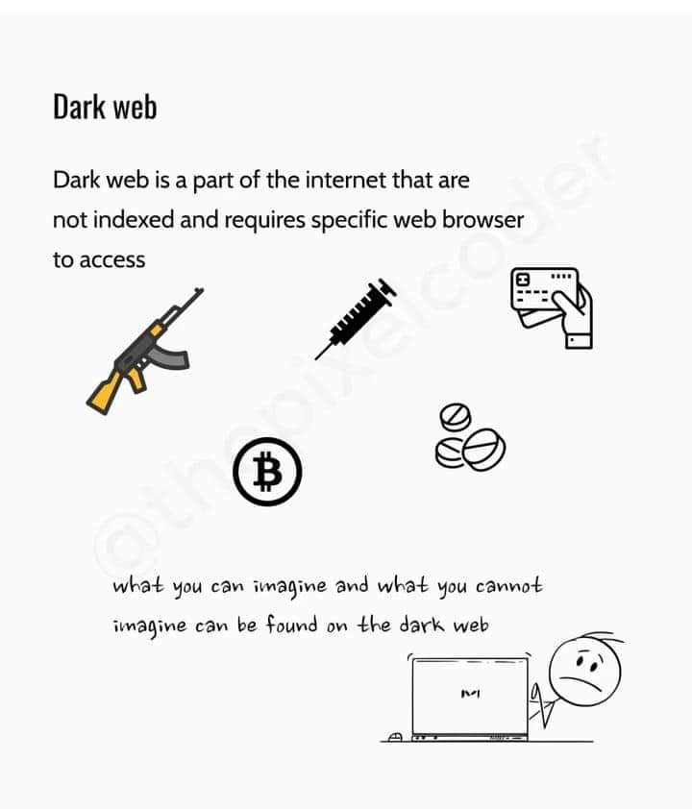

Slide 7
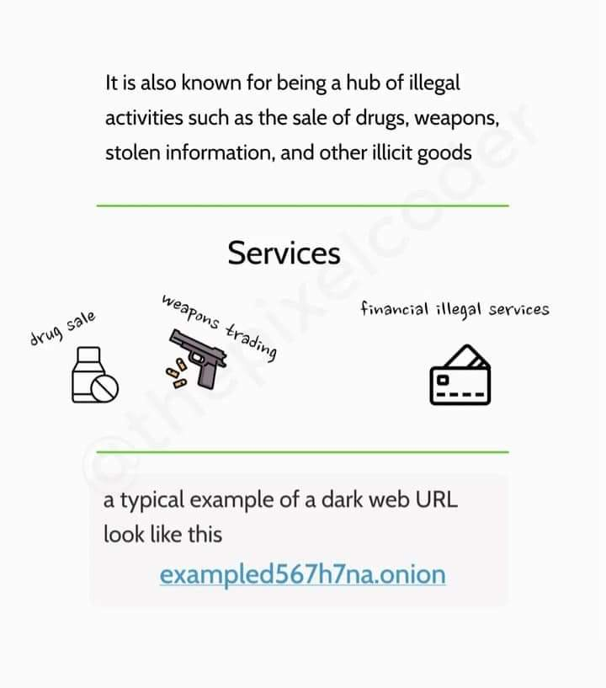

Slide 8
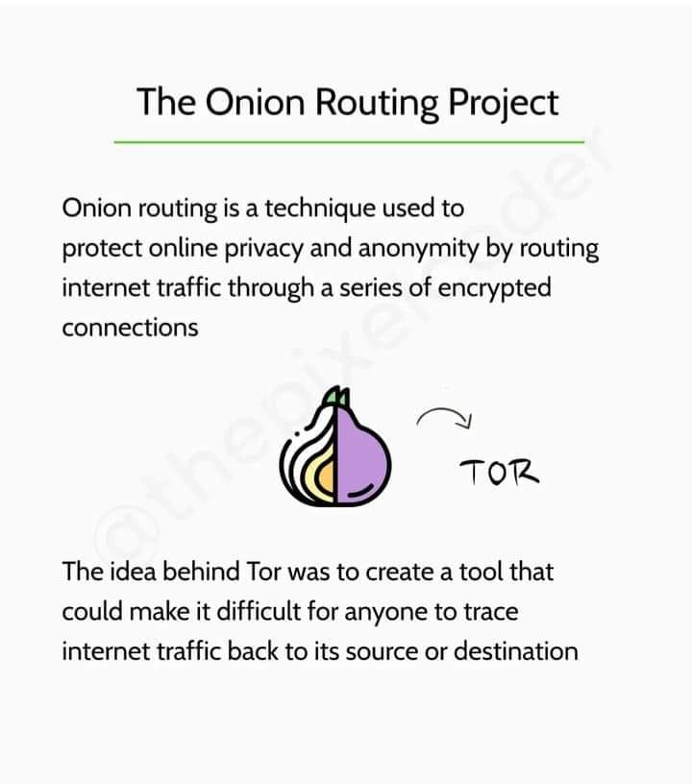

Slide 9
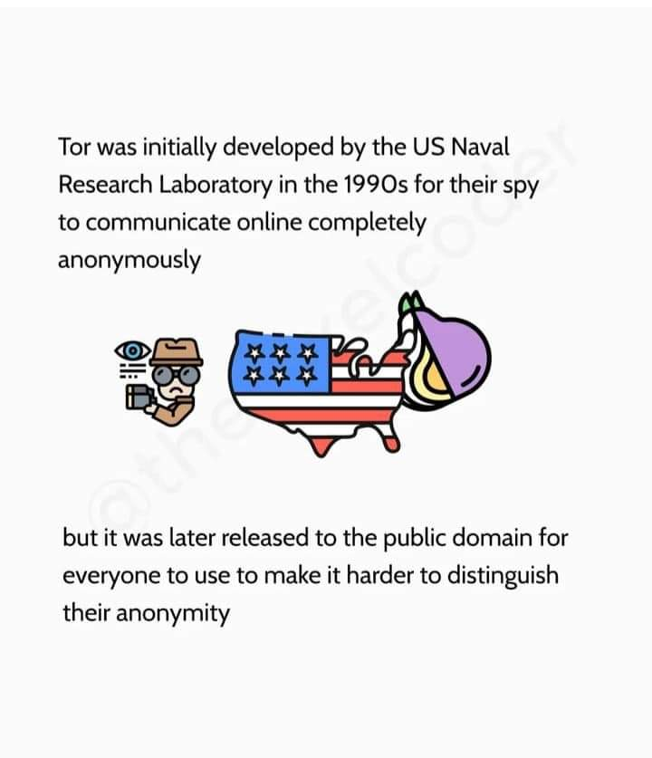

Slide 10
Thank You! For Giving Your Important Time. “Keep Learning & Keep Exploring”.

